Slide 1
U.S. Legal System

Slide 2
Civil Liberties:
A Review

Slide 3
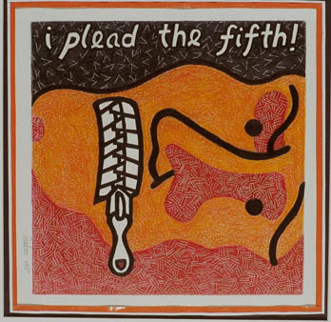
What are constitutional rights of an accused person?
Brainstorm rights under:
  4th amendment (1)
  5th amendment (4)
  6th amendment (5)
  8th amendment (2)
  14th amendment (2)
  U.S. Constitution (not including the amendments) (2-3)
  Common law (judge-made law)
    (at least 3)

Slide 4
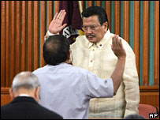
Rights of the U.S. Constitution
Due Process (5th & 14th A.) ~ Gov’t may not take individual lives, liberty, or property without the proper exercise of the law.
Equal Protection (14th A.) ~ equal treatment regardless of race, gender, or class.

Slide 5
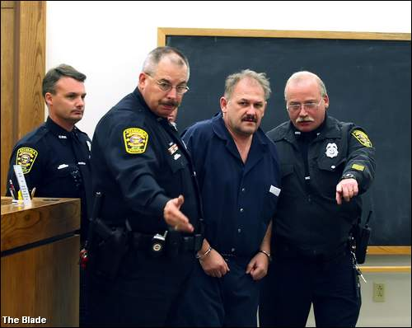
Writ of Habeas Corpus
Requires an official who has made an arrest to bring that person to court and explain why he/she is being held.

Slide 6
4th Amendment
Protection against illegal searches & seizures (police need “probable cause” to obtain a search warrant).

Slide 7
5th Amendment
Grand Jury ~ to determine if there is enough evidence against you to hold a trial.
Self Incrimination ~ you cannot be forced to testify against yourself (right to remain silent).
Double Jeopardy – can’t be tried twice for the same crime.

Slide 8
6th Amendment
Attorney representation.
Speedy trial.
Trial by impartial jury.
Confront witnesses and accusers.
Be told of charges against you.

Slide 9
8th Amendment
No cruel or unusual punishment.
No excessive bail.
  A sum of money an arrested person pays to a court in order to win release from jail while waiting for trial.
  If person shows up for trial, bail money is returned after the trial

Slide 10
Additional Rights
Miranda v. Arizona – must be read your Miranda rights when arrested.
Gideon v. Wainwright – right to an attorney even if you cannot afford one.
Mapp v. Ohio – evidence obtained through an illegal search cannot be used against you.

Slide 11
Warm-Up Questions
Why do we need laws? What purpose do laws serve?
Should laws treat different crimes in alternative ways? (i.e., should the law and punishment for murder be different than the law and punishment for theft?) Why?
How do laws currently affect your life?

Slide 12

Laws
Defined ~ A set of rules that allow people to live peacefully in society.
Jurisprudence – the study of laws.

Slide 13
Purpose of Laws
Provide security (for people & property)
Provide predictability
    Why is this important?
Conflict resolution through neutral 3rd parties (i.e., the courts)
Reflect and enforce conformity to society’s values
Distribute the benefits & rewards society has to offer and allocate the costs of those good things.
    Ex. - Welfare benefits, taxes & tax breaks

Slide 14
Origin of our Laws

Slide 15
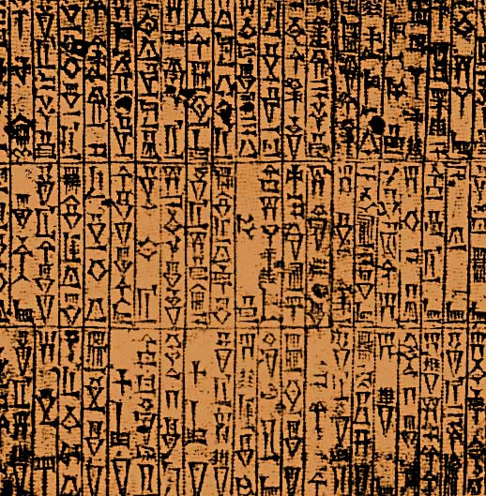
Code of Hammurabi
First known system of written law (1760 BC).
Collection of 282 laws regulating everyday behavior with harsh punishments.
“An eye for an eye, tooth for a tooth”
Hammurabi’s Code

Slide 16
Code of Hammurabi
EXAMPLES:
If any one steals the property of a temple or of the court, he shall be put to death, and also the one who receives the stolen thing from him shall be put to death.
If a son strikes his father, they shall cut off his hand.

Slide 17
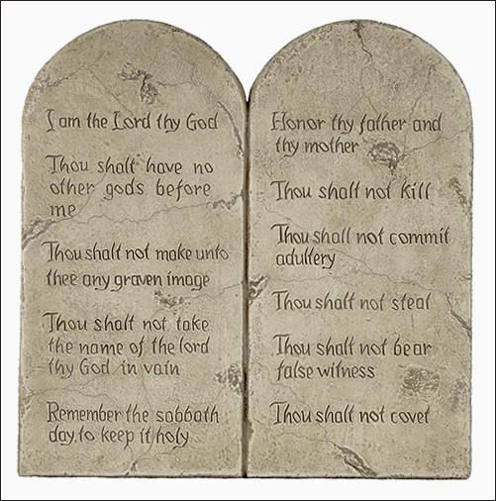
The Ten Commandments
A list of moral & religious rules.
Contains many principles still used today. (Thou shall not kill, steal, etc.)

Slide 18

Roman Law
Twelve Tables ~ written set of laws for the Roman people.
Emperor Justinian later simplified Roman laws into the “Justinian Code”.

Slide 19
American Legal Tradition
Three basic features of our legal system:
Common Law Tradition
Adversarial
Litigious

Slide 20
Common Law vs. Civil Law
Common Law System– legal system based on the accumulated rulings of judges over time, applied uniformly (aka: “judge-made law”)
  Judges rely on “precedent” (or stare decisis) in making decisions.
    What does this mean with respect to how judges make decisions?
  Developed in Great Britain

Slide 21
Common Law vs. Civil Law
Civil Law System– legal system based on a detailed comprehensive legal (written) code (usually created by the legislature).
  Used in most industrialized nations & Louisiana.
  Implications:
    Few procedural protections.
    More emphasis on getting the appropriate outcome than on maintaining integrity of the procedures.

Slide 22
Adversarial vs. Inquisitorial System
Adversarial system – trial procedures are designed to resolve conflict through the clash of opposing sides, moderated by a neutral, passive judge whose job is to apply the law.

Slide 23
Adversarial vs. Inquisitorial System
Inquisitorial system – trial procedures designed to determine the truth through the intervention of an active judge who seeks evidence and questions witnesses.
  Compare & Contrast: In what ways is the civil law/inquisitorial system different than our common law/adversarial system?
    Think: role of judge, jury, attorneys, speed, …

Slide 24
Compare & Contrast
Civil Law/Inquisitorial System
Common Law/Adversarial System
Judges - take an active role in determining the facts & truth.
Juries - none
Attorneys – only a minor role
Faster & cheaper (fewer expensive atty fees).
Less theatrics
Judges - impartial referees who don’t take an active role in discovering the truth – mainly there to ensure guarantee of procedural rights.
Juries – determine the facts & truth
Attorneys – have lot of power

Slide 25
Litigious System
Americans like to sue one another – a lot!
  HUGE issue in American with many concerns – many have proposed to put a cap on awards (such as a cap on medical malpractice awards).
  What are the arguments for and against allowing citizens to sue each other in such an unlimited manner?
  What is a “frivolous” lawsuit and what are the problems with such lawsuits?

Slide 26
Types of Laws in the U.S.

Slide 27
Substantive vs. Procedural Laws
Substantive laws – laws which define what we can and cannot do legally.
Procedural laws – laws that establish how laws are applied and enforced
  i.e., rules for how legal proceedings must take place
These 2 laws sometime clash – there is much debate on this topic –what is your opinion & arguments for and against?
  Do you think that someone who murders your loved-one should be let off bc the police failed to read that person their Miranda rights or obtained the murder weapon in a warrantless search?
  OR are a person’s procedural rights so important that they should trump substantive laws/or even the victim’s rights?

Slide 28
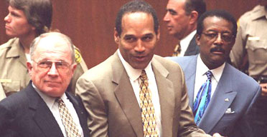
Criminal Law
Laws that prohibit behavior that the gov’t believes to be harmful to society.
  Examples of criminal laws?
  Considered to be “crimes against the state”
    Who is always the prosecutor in a criminal case?

Slide 29
Civil Law
Laws regulating interactions btw individuals – injury done to a specific individual.
  Examples of civil laws?
  What do you call a violation of a civil law? A criminal law?
  Types of damages in a civil case that might be awarded – compensatory &/or punitive.
    What is the difference?
Watch: Hot Coffee

Slide 30
Criminal vs. Civil Law
Do these laws and cases ever overlap? (i.e., can you be tried both under criminal & civil law?)
  Examples?
Why can there be different outcomes for the same action?
  How many jurors in a criminal case need to find a defendant guilty?
  What are those burdens of proof?
  Why is there a difference in the burdens of proof depending on whether it is a criminal or civil case?

Slide 31
Constitutional Law
Laws that are set forth in the Constitution or decisions made by the courts regarding the meaning & interpretation of the Constitution (refers back to our common law tradition).
  Examples?
  Examples of constitutional law overlapping w/criminal law cases?

Slide 32
Administrative Law
Laws made by the bureaucracy on behalf of Congress.
  Often regulates what business & industries can and cannot do.
  Examples of administrative laws?

Slide 33
Statutory Law
Laws made by a state or federal legislature.
  Includes criminal, civil & administrative laws.
  Reflects the will of the people – why is so?

Slide 34

International law
Laws established between nations relating to trade, commerce, or immigration.
  Examples: Trade agreements; Peace Agreements; Immigration restrictions.

Slide 35
Executive Orders
REVIEW:
  What are they?
  For how long are they binding?
  Examples from the past 5 years?
  Famous examples from history?

Slide 36
Law Enforcement Agencies

Slide 37
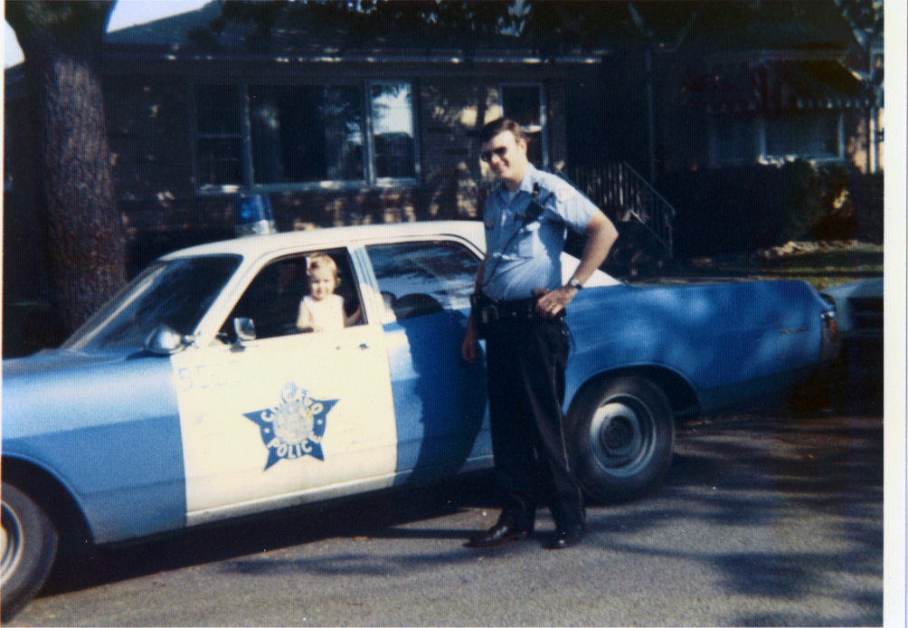
City Police Department
Jurisdiction within city limits.

Slide 38

Sheriff’s Office
Jurisdiction within county limits, but outside of city limits.

Slide 39

State Trooper/Patrol
Jurisdiction over all state and U.S. highways.

Slide 40

Federal Bureau of Investigation (FBI)
Jurisdiction in federal matters.

Slide 41
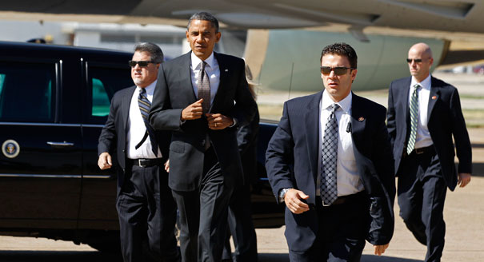
U.S. Secret Service
Also jurisdiction in federal matters, but focused on:
  Protection of major gov’t officials.
  Counterfeiting
  Financial fraud & identity theft

