Slide 1
INTRODUCTION TO POLITICS

Slide 2
Politics
The process of deciding who gets what, when, and how.
Key concepts in politics:
Power
What are examples of power in everyday life?
Legitimate
Accepted as “right” or proper
Authority
-Power that is recognized as legitimate
Resources
Always be winners and losers in politics
Government

Slide 3
Functions of Government
What do you think are some of the functions of government?
Keep Order
Provide Security/Protection
Provide Services
Guide the community
What is “social order”?
Why do we want or strive for “social order”?

Slide 4
Rights, Duties & Responsibilities
“American citizens have both rights, duties and responsibilities.”
What does this statement mean?
What is the difference between these three terms?

Slide 5
Duties and Responsibilities
Duties
Pay taxes
Obey the law
Serve in court
Defend the nation
Go to school
Responsibilities
--Vote and speak up!
--Be informed
--Respect the rights of others
--Respect diversity
--Participate in the community
Rights – Liberty, Equality, Security

Slide 6
Economic Systems
Difference in economic systems?
– how much control a government has over decisions regarding economic production and distribution of wealth.
Two main types of economic systems?
How do they differ?
Country examples of each?
Can the two ever co-exist?
Two different types of capitalism?
When is government allowed to intervene and regulate in “regulated capitalism”?

Slide 7
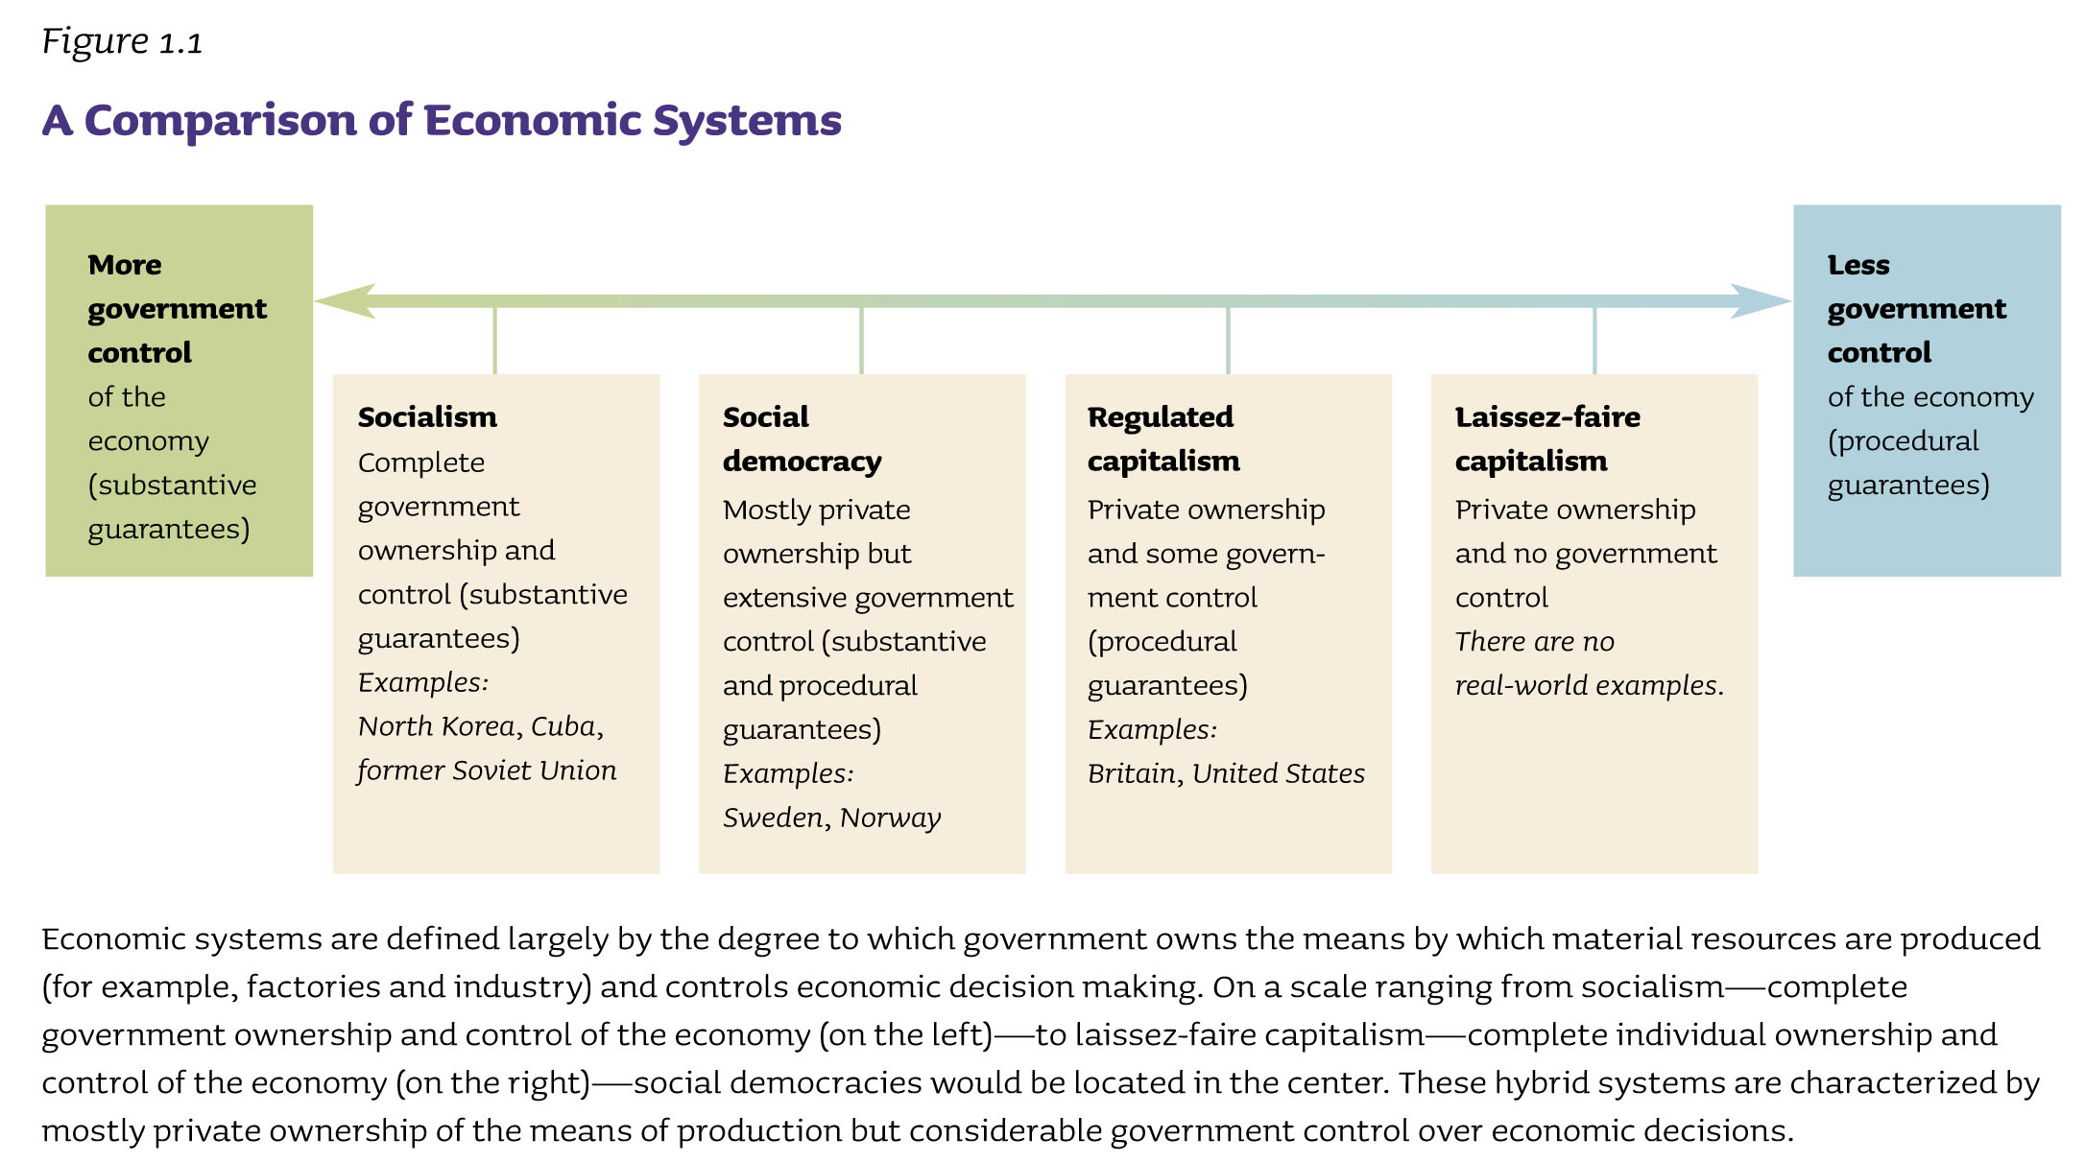

Slide 8
Political Systems
Difference in political systems?
– how much power & control a government has over individuals’ lives.
Authoritarian vs. Democracy
Examples of authoritarian type political systems?

Slide 9
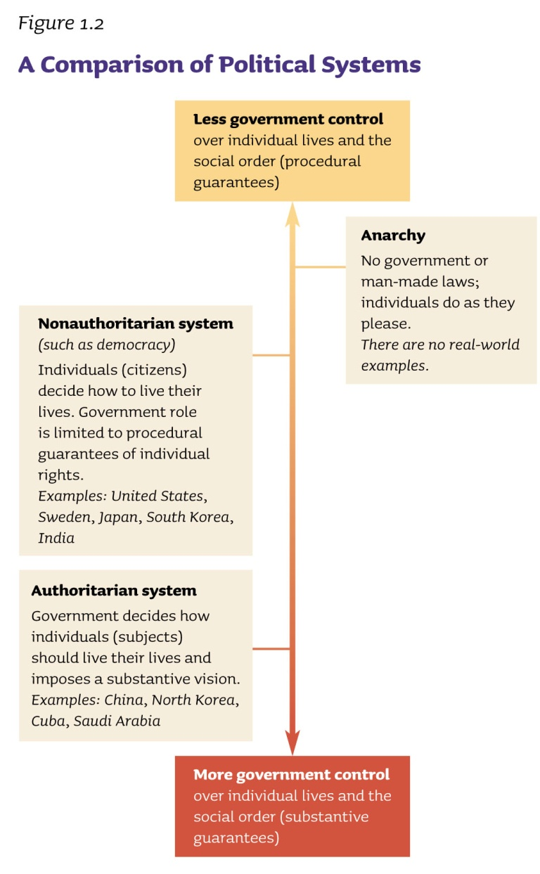

Slide 10
Procedural vs. Substantive Guarantees
Procedural Guarantees
Government assurance of fair rules and process (treat everyone fairly - but do not provide a particular outcome)
What is meant by this?
Substantive Guarantees
Government assurance of what they believe to be fair outcomes.
What is meant by this?

Slide 11
Direct vs. Representative Democracy
Differences?
What type of democracy do we have in the U.S.?
How is this type of democracy justified in the U.S.?
Direct democracy is not practical and inefficient – too many people.
Many believe direct democracy is likely to lead to bad decisions because of fleeting passions…

Slide 12
What is a “republican” form of government (aka: a “republic”)?
Essay question on the 2013 AP exam.
=A gov’t in which decisions are made through (elected) representatives of the people

Slide 13
Competing Views of Citizenship
Just how much democracy should exist?
Madison’s view?
Opposing view?
Did this always happen during the issues of slavery or during civil rights?
Which view do you think is most accurate and why?
Would you be willing to sacrifice your own self- advancement for the good of the whole?
Whose view won out?

Slide 14
Theories of Democracy
Elite Democracy
Citizen’s role is limited to choosing among competing leaders.
Pluralist Democracy
Citizen membership in groups is key to political powers.
Participatory Democracy
Citizens should actively and directly control all aspects of their lives.

Slide 15
Competing views of how “political power” is distributed in America:
Marxist/Class View
Gov’t is dominated by capitalists (economic forces).
Power Elite View
Gov’t. is dominated by a few top leaders, most of whom are not elected.
Corporate, military, labor unions, special interest groups, mass media leaders
Bureaucratic View
Gov’t is dominated by appointment officials (career gov’t workers).
Pluralist View
Competition among ALL affected interests shapes policy
System of political haggling and compromise)

Slide 16
“A Republic, Madam, if you can keep it” – Benjamin Franklin
What did Franklin mean by this statement?
Do you think that if Benjamin Franklin were alive today that he would say that American citizens have succeeded in keeping a republic?

Slide 17
“Those who would give up essential liberty to purchase a little temporary safety deserve neither liberty nor safety.” -Benjamin Franklin
What did Franklin mean by this statement?
Do you agree with him?

