Slide 1
Foreign Policy

Slide 2
50 Terms you should already know
26th amendment
9/11
Afghanistan/Iraq
Ambassador
American Revolution
Bully Pulpit
Checks and Balances
Chief Diplomat
CIA
Civil War Amendments
Cold War
Commander in Chief
Communism
Congress
Department of Defense
Department of Homeland Security
Department of State
Diplomacy

Slide 3
50 Terms you should already know
Draft
Embassy
Executive Agreement
Farewell Address (GW)
Foreign Aid
Foreign Policy
Green Card
Guantanamo Bay
International Trade
National Security
National Security Council
NSA
Passport
Patriot Act
Pearl Harbor
Power of the Purse
Power of the Sword
Public Approval

Slide 4
50 Terms you should already know
Rally around the Flag
Sanction
Schenk v. U.S.
Security vs. Liberty
Senate Foreign Relations Committee
Shays’ Rebellion
Superpower
Terrorism
Third World
Treaty
U.S. v. O’Brien
Vietnam War
Visa
War Powers Act

Slide 5
Foreign Policy – Key Concepts
Foreign Policy – A country’s official positions, practices, and procedures for dealing with actors outside its borders; it includes diplomacy and defense policy
Diplomacy – the formal system of communication and negotiation between countries
Defense Policy – area of policy making that focuses on the strategies that a country uses to protect itself from its enemies
Hegemon – the dominant actor in world politics

Slide 6
An Evolving Foreign Policy
Outline the major events and issues in the development of US foreign and defense policy

Slide 7
Evolving foreign policy
Early Republic – Isolationism
An Emerging Power – Manifest Destiny & Imperialism
World War I & Aftermath – Neutrality, Interventionism
World War II & Aftermath – Neutrality, Interventionism
Cold War – Containment
Post Cold War – Economic Diplomacy/Internationalism
War on Terror – Antiterrorism and Counterterrorism
Notes:
The largest foreign policy challenge of the young republic was charting a safe course between European giants Great Britain and France. This was complicated by the fact that Alexander Hamilton and Thomas Jefferson disagreed; Hamilton wanted policies that favored the British, while Jefferson favored France.
Given these conflicts, young America, led by George Washington, embraced a policy of neutrality and isolationism. Washington, in his farewell address, urged Americans to steer clear of "entangling alliances."
When peace was established between France and Great Britain, Americans feared one or both countries would try to re-establish power in the Western Hemisphere. The Monroe Doctrine declared that any attempt to expand in this area would be seen as a danger to American safety.

Slide 8
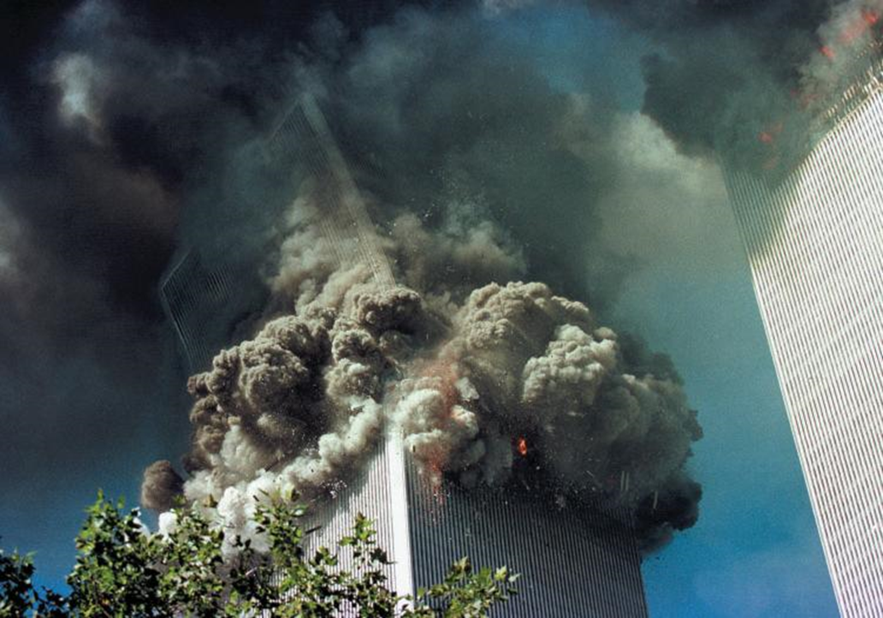
September 11th and the War on Terror
September 11
Nineteen members of al-Qaeda hijacked four commercial airplanes.
Two crashed into the World Trade Center, one into the Pentagon, and one in a field in Pennsylvania
The War in Afghanistan
U.S.-led coalition sought to depose the government and deny a safe haven to terrorists.
Osama bin Laden captured and killed in 2011
Notes:
President George W. Bush distanced himself from the Clinton expansionist policies that had led to U.S. intervention in foreign humanitarian crises. He rejected the international global warming treaty known as the Kyoto Protocol and refused to participate in other international efforts.
On September 11, 2001, 19 members of the terrorist group al-Qaeda headed by Osama bin Laden hijacked four planes. Two crashed into the World Trade Center, one into the Pentagon and one in a field in Pennsylvania. This sparked the global war on terrorism. The U.S. sent troops into Afghanistan to force the Taliban government to expel al-Qaeda. Although the government fell, terrorist groups remained as guerrilla fighters, and U.S. troops remained to fight them.
Activity: Ask the students to prepare an impromptu debate on the U.S. presence in Afghanistan. Choose two teams of four students to serve as opposing sides in the debate. Give them ten minutes to prepare arguments. Allot total debate time according to the demands of your class schedule. Ask the remaining students to act as debate judges.

Slide 9
September 11th and the War on Terror
The War in Iraq
President George W. Bush declared Iraq, North Korea, and Iran an “axis of evil.”
Operation Iraqi Freedom (2003)
Divided Americans
Not intended to be a long, drawn-out war
Last American combat forces left in 2011.
New Terrorist Threats
ISIS
Notes:
In his 2002 State of the Union Address, President George W. Bush declared Iraq, North Korea, and Iran an "axis of evil." Not long after, Operation Iraqi Freedom began on March 19, 2003. Within a month, the capital city of Baghdad fell and Bush declared "mission accomplished." Casualties began to mount in what become a long, drawn-out war, and it wasn't until December, 2011, that the last combat forces pulled out of Iraq.
Following massive upheaval across the Middle East, a virulent new terrorist threat has arisen—the Islamic State in Iraq and Greater Syria, commonly known by the initials ISIS or, sometimes, ISIL. Displaying extreme and graphic brutality, but also an exceptional adeptness in the use of social media and other forms of propaganda, ISIS poses a major challenge to U.S. foreign and defense policy.

Slide 10
Who Makes Foreign Policy?
The Constitution
The Executive Branch
Congress
The Judiciary
Interest Groups and Political Parties
Notes:
The basics of American foreign policy are laid out in the Constitution. The executive branch is the most powerful when it comes to foreign policy. Congress also plays an important role, but the Judiciary generally does not. In this section, we will explore how American foreign policy is made.

Slide 11
The Constitution
Foreign Policy Powers
Granted to the national government
Divided between the president and Congress
Presidential Powers
Commander in chief
Appoints ambassadors, subject to Senate approval
Congressional Powers
Funds military
Declares war
Notes:
The framers of the Constitution granted power to make foreign policy to the national government, not the states. They further divided authority for foreign policy between the president and Congress.
The president is commander in chief of the military, but Congress funds the military and formally declares war. The president appoints ambassadors and other key foreign policy officials, while the Senate confirms those appointments.

Slide 12
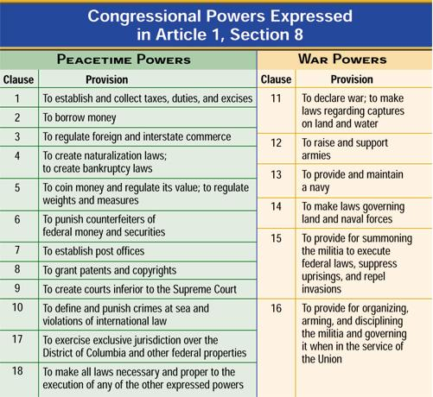

Slide 13
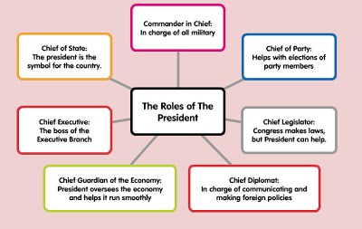

Slide 14
The Executive Branch
The President
Relies on National Security Council
The Departments of State, Defense, and Homeland Security
State Department formulates foreign policy.
Defense Department formulates military policy.
Joint Chiefs of Staff - Military advisory body that includes the Army chief of staff, the chief of naval operations, and the Marine commandant
Homeland Security straddles both areas.
The Intelligence Community
Central Intelligence Agency
Notes:
The executive branch determines foreign and defense policy. The president relies on the expertise of the National Security Council and his cabinet. The Department of State is generally in charge of formulating foreign policy. The Department of Defense formulates military policy, and the Department of Homeland Security straddles both policies.
The intelligence community comprises all the agencies involved in the collection and analysis of information. The Central Intelligence Agency had been the head of the intelligence community until the Director of National Intelligence was created after the 9/11 attacks. The DNI is aided in its efforts by the FBI, The Department of Homeland Security, and the National Security Agency.

Slide 15
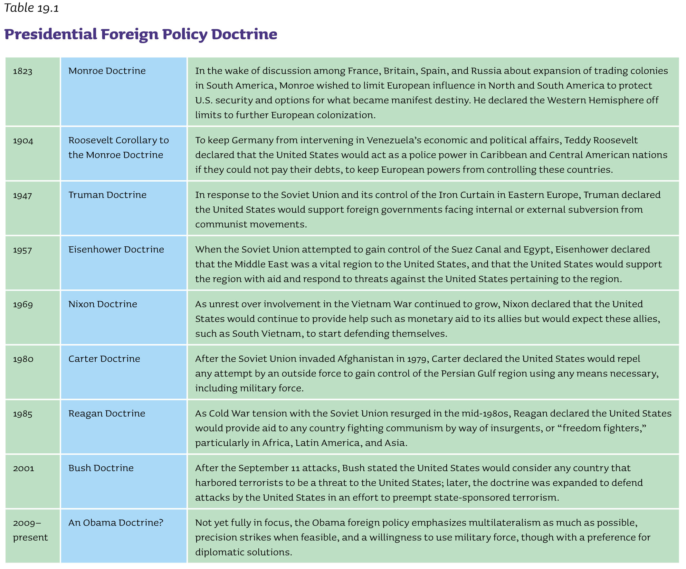

Slide 16
The Executive Branch
The President
Relies on National Security Council
The Departments of State, Defense, and Homeland Security
State Department formulates foreign policy.
Defense Department formulates military policy.
Joint Chiefs of Staff - Military advisory body that includes the Army chief of staff, the chief of naval operations, and the Marine commandant
Homeland Security straddles both areas.
The Intelligence Community
Central Intelligence Agency
Notes:
The executive branch determines foreign and defense policy. The president relies on the expertise of the National Security Council and his cabinet. The Department of State is generally in charge of formulating foreign policy. The Department of Defense formulates military policy, and the Department of Homeland Security straddles both policies.
The intelligence community comprises all the agencies involved in the collection and analysis of information. The Central Intelligence Agency had been the head of the intelligence community until the Director of National Intelligence was created after the 9/11 attacks. The DNI is aided in its efforts by the FBI, The Department of Homeland Security, and the National Security Agency.

Slide 17
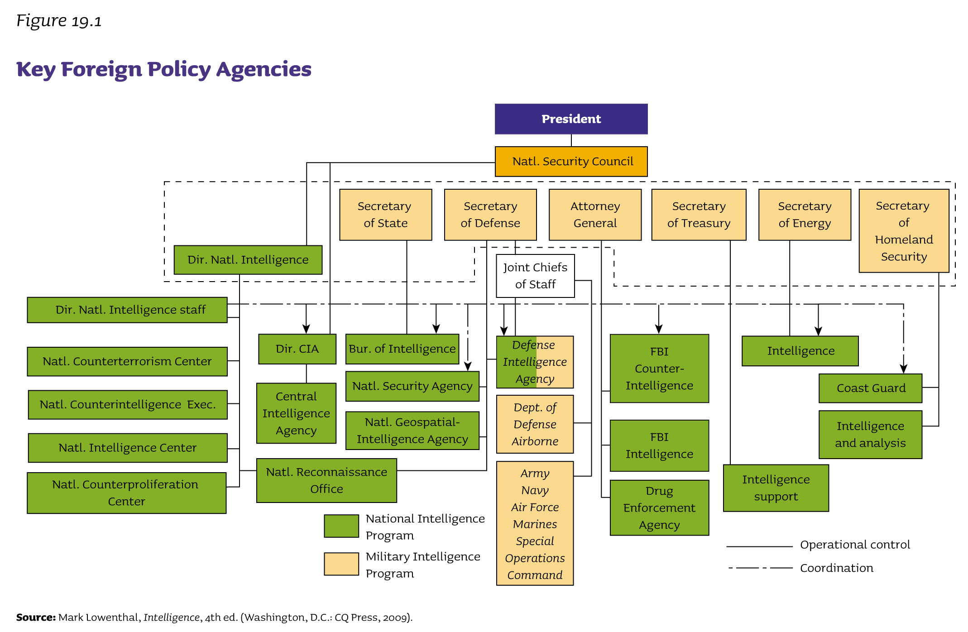

Slide 18
Congress
Oversight
Hearings to monitor agency actions
“Fact-finding” missions abroad
Treaties and Executive Agreements
Treaties require Senate approval, while executive agreements do not.
Appointments and Appropriations
Senate responsible for approving or rejecting presidential appointments
Can cut funding for military action
War Powers
War Powers Resolution - President reports to Congress within forty-eight hours.
Ineffective restraint on presidential power
Notes:
Congress does not have as much influence over foreign policy as the president does. It can hold hearings to monitor agency actions and conduct "fact-finding" missions abroad.
Treaties require Senate approval, and it is rare that the Senate does not approve them. Presidents have used executive agreements when they want to avoid getting the Senate's approval. These executive agreements usually deal with routine foreign matters, but they have also involved major military commitments.
The Senate approves key presidential foreign policy appointments.

Slide 19
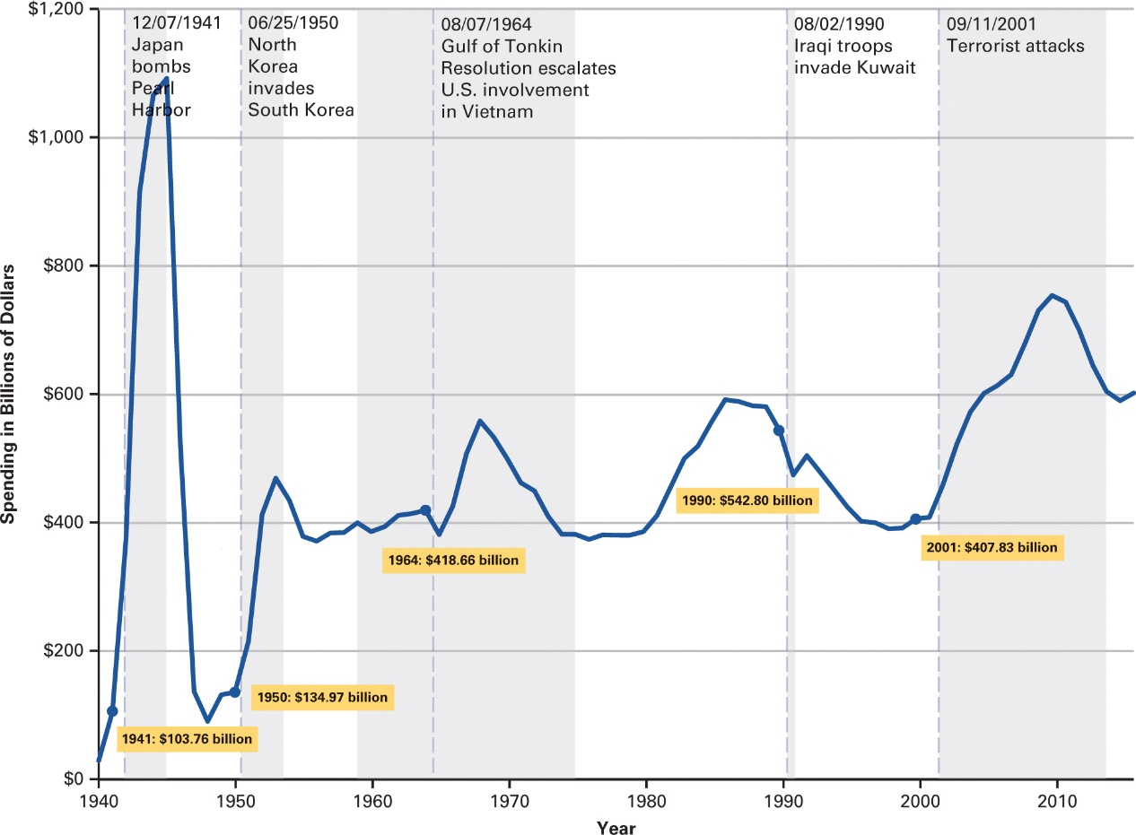
How Has Defense Spending Changed Over Time?
Source: US Office of Management and Budget, Table 3.1—Outlays by Superfunction and Function: 1940–2021.
Notes:
Defense spending was at its highest absolute levels during World War II, and at its second highest in the post-9/11 period. Above is chart on US spending on national defense since 1940, presented in billions of 2005 dollars.

Slide 20
Congress
Oversight
Hearings to monitor agency actions
“Fact-finding” missions abroad
Treaties and Executive Agreements
Treaties require Senate approval, while executive agreements do not.
Appointments and Appropriations
Senate responsible for approving or rejecting presidential appointments
Can cut funding for military action
War Powers
War Powers Resolution - President reports to Congress within forty-eight hours.
Ineffective restraint on presidential power
Notes:
Congress does not have as much influence over foreign policy as the president does. It can hold hearings to monitor agency actions and conduct "fact-finding" missions abroad.
Treaties require Senate approval, and it is rare that the Senate does not approve them. Presidents have used executive agreements when they want to avoid getting the Senate's approval. These executive agreements usually deal with routine foreign matters, but they have also involved major military commitments.
The Senate approves key presidential foreign policy appointments.

Slide 21
War Powers Act
Resolution The president is limited in the deployment of troops overseas to a 60 day period in peacetime and must notify Congress, within 48 hours, if troops are moved into hostilities or where hostilities are imminent.
Purpose: Meant to stop endless (Vietnam) and secret (Cambodia) wars
Questions:
What was Nixon’s Response? Why?
How has it been received since then?
Notes:
The president by and large reports to Congress but does so “consistent with, but not pursuant to” the provisions of the War Powers Act. Thus the 60-day clock does not start. Congress has been unable to start that clock on its own, though the act gives that option. One notable example of a negotiation over the clock was during the Reagan administration with troops in Lebanon. The 60-day clock was extended to an 18-month agreement with Congress. The recent debate over whether U.S. action in Libya constituted “hostilities” or not is an interesting current application.

Slide 23
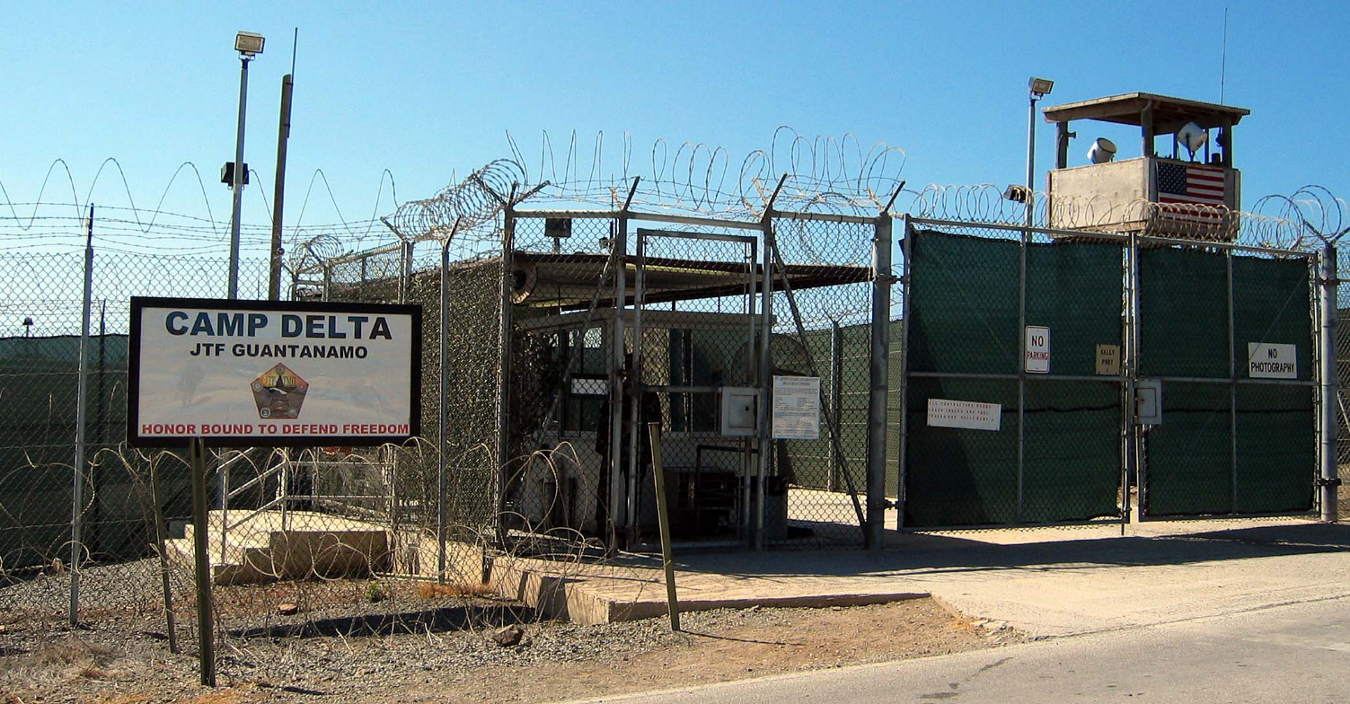
The Judiciary
Limited Role in Foreign and Defense Policy
Why are the federal courts unwillingness to intervene in such topics?
When do the courts intervene?
Notes:
The Judiciary's role in foreign and defense policy is fairly limited. The Court tends to dismiss disputes over foreign policy as political in nature.
On the relatively infrequent occasions in which the courts do intervene on foreign and military affairs, it is often to protect a core civil liberty. For instance, the federal courts have ruled on habeas corpus with respect to suspected terrorists who have been detained without trial at Guantanamo Bay, Cuba.

Slide 24
Foreign Policy: Contemporary challenges
Notes:
We continue to face significant foreign and defense policy challenges. Four of the most important are trade, terrorism, nuclear weapons, and global climate change. We'll take an in-depth look at those three in this section.

Slide 25
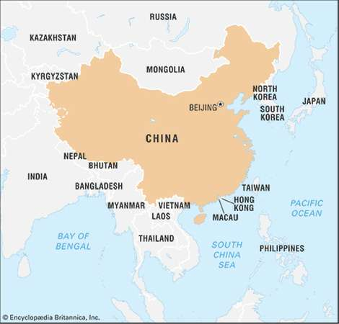
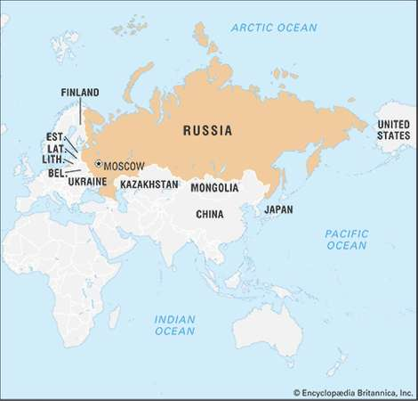
China
Russia
Notes:
Both the United States and China benefit from trade and globalization; both want to limit the spread of nuclear weapons; and both are served by reining in countries such as Iran and North Korea that threaten peace and stability. Still there are considerable tensions and mistrust as well. China depends on the U.S. market to sell exports and fuel its economic growth. The United States borrows heavily from China, which finances growing U.S. budget deficits by purchasing American Treasury bonds. This type of interaction creates a potentially unhealthy mutual dependency for economic prosperity.
At the same time, China is modernizing its navy, missiles, aircraft, cyber warfare capabilities, and anti-satellite weapons. In a move deemed provocative by many of its neighbors, China has even constructed artificial islands in the South China Sea and
claimed sovereignty over them—giving it a stronger foothold for military action and a tighter grip on a major transit route for global trade. In response, the United States has begun deploying more military forces in the Pacific, including a new deployment
of 2,500 Marines in Australia. It has also strengthened and even expanded its partnership with India, Japan, South Korea, and other Asian countries who serve as regional counterweights to China in the Asia-Pacific region.

