Slide 1
Domestic Policy
Chapter 16

Slide 2
A beginner’s guide to understanding the economy
Adam Smith
Arbitration
Articles of Partnership
Automation
Board of Trustees
Bond
Capital
Capital Goods
Capitalism
Charter
Collective Bargaining
Command
Communist Manifesto
Complement
Consumer
Consumer Goods
Corporation
Cost
Demand
Demand Curve
Dividend
Division of Labor
Downsizing
Economics
Elastic
Entrepreneurship
Equilibrium Price
Factors of Production
Fixed Cost
Free Market
Goods
Inelastic
Investment
Karl Marx
Labor
Labor Union
Laissez-Faire
Land/Natural Resources
Law of Supply & Demand
Macroeconomics
Manufacturing
Marginal Cost
Mediation
Merger
Microeconomics
Monopoly
Mutual Fund
Needs
Opportunity Cost
Partnership
Price
Productivity
Profit
Regulations
Resources
Revenue
Scarcity
Services
Shortage
Sole Proprietorship
Specialization
Stock
Stock Market
Strike
Subsidies
Substitute
Supply
Supply Curve
Surplus
Taxes
Technology
Total Cost
Trade-Off
Traditional
Unemployment
Union
Variable Cost
Wants
Wealth of Nations

Slide 3
A beginner’s guide to understanding the economy
Economics – the study or science that deals with the production, distribution, and consumption of goods and services, or the material welfare of humankind.
Macroeconomics
Microeconomics
Economic Policy – all the different strategies that government officials employ to solve economic problems.
Two Questions:
What kinds of problems?
Impact of laissez faire and Great Depression?

Slide 4
A beginner’s guide to understanding the economy
The laws of supply and demand
Basic principles that regulate the economic market and influence the price of a good
The Impact of Price:
Prices rise as demand rises. Prices fall as demand falls.
Prices fall as supply rises. Prices rise as supply falls.
Gross domestic product
Total market value of all goods and services produced by everyone in a country during one year

Slide 5
Factors that impact supply and demand
Supply
Demand
Changes in the cost of resources
Productivity
Technology
Changes in government policies
Changes in taxes or subsidies
Changes in the number of consumers
Changes in substitutes
Changes in complements
Changes in consumers’ income, taste or expectation

Slide 6
Economic indicators
Supply and Demand
GDP – Gross Domestic Product
Consumer Price Index
Housing Prices
Federal Debt
Stock Market…
Inflation
Business Cycle
Unemployment

Slide 8
Economic indicators
Supply and Demand
GDP – Gross Domestic Product…
Consumer Price Index
Housing Prices
Federal Debt
Stock Market…
Inflation
Business Cycle
Unemployment

Slide 9
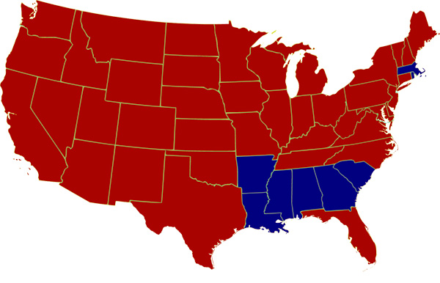
Election of 1928 Results…

Slide 10
Causes of the Great Depression
Stock Market Crash/market speculation
Concentration of wealth
Rest of the world (global economic issues)
Excessive goods (overproduction)
Weak farm economy (and agricultural issues)
Excessive use of credit
Direction of government and monetary policies

Slide 11
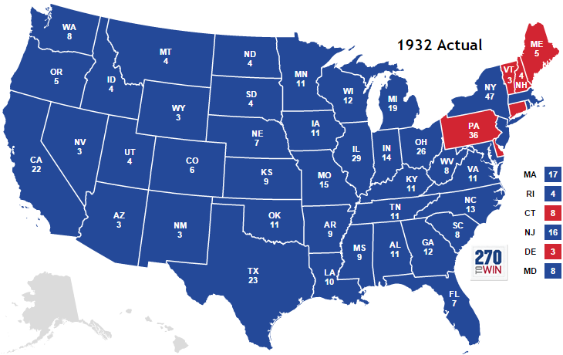
Election of 1932 Results…

Slide 12
Economic indicators
Supply and Demand
GDP – Gross Domestic Product…
Consumer Price Index
Housing Prices
Federal Debt
Stock Market…
Inflation – an increase in the price of goods and services
Stagflation and Hyperinflation
Business Cycle…
Unemployment

Slide 13
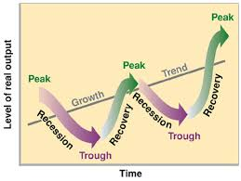
A beginner’s guide to understanding the economy
Cyclical nature of capitalism, whether regulated or not
Business cycles
Economic booms
Economic busts

Slide 14
A beginner’s guide to understanding the economy, cont’d.
Recession: a decline in GDP for two consecutive quarters
Depression: a sharp reduction in the nation’s GDP for more than a year accompanied by high unemployment
Self-regulating market: an ideal market that corrects itself when it moves in an inflationary or recessionary direction

Slide 15
Fiscal vs. monetary policy
Fiscal policy
Government regulates the economy through its powers to tax and spend
President and Congress play the major roles
Keynesianism?
Monetary policy
Government regulates the economy by manipulating interest rates
The Fed plays the major role
Interest rates?
Fiscal Policy vs. Monetary Policy

Slide 16
Fiscal Policy
Fiscal Policy – Deliberate use of government’s taxing and spending to maintain economic stability
Historical Foundation
Prior to the 1930s – Laissez-fair
Great Depression – Keynesian Economics – spending by government can stimulate economic growth much faster than a free market could on its own
1960s – Budget Deficit: Greater government spending, even at the expense of an increase in the budget deficit, was needed to achieve full employment
1970s – Stagflation
1980s – “Supply-Side Economics”: Deep cuts in the tax rates paid by high earners would stimulate growth

Slide 17
Fiscal policy

Slide 18
Fiscal Policy
National Debt and Deficit
No Limit to Annual Federal Budget Deficit or National Debt
Budget Deficits Became the Norm in the 1980s.
Economic Slowdown of 2008
Troubled Assets Relief Program (TARP)
American Recovery and Reinvestment Act
Budget Control Act of 2011
Automatic debt ceiling increases
Triggered automatic spending cuts in 2013

Slide 19
History of the budget process
The Budget and Accounting Act of 1921
No formal process before this law
Created the Office of Management and Budget (OMB) to assist the president
Question: What role does the OMB play?
The Congressional Budget and Impoundment Act of 1974
The House and Senate Budget Committees, Joint Resolution
How did Reagan change the process?
The Gramm-Rudman Act of 1985
Automatic 10% spending cuts
Why didn’t this work?

Slide 20
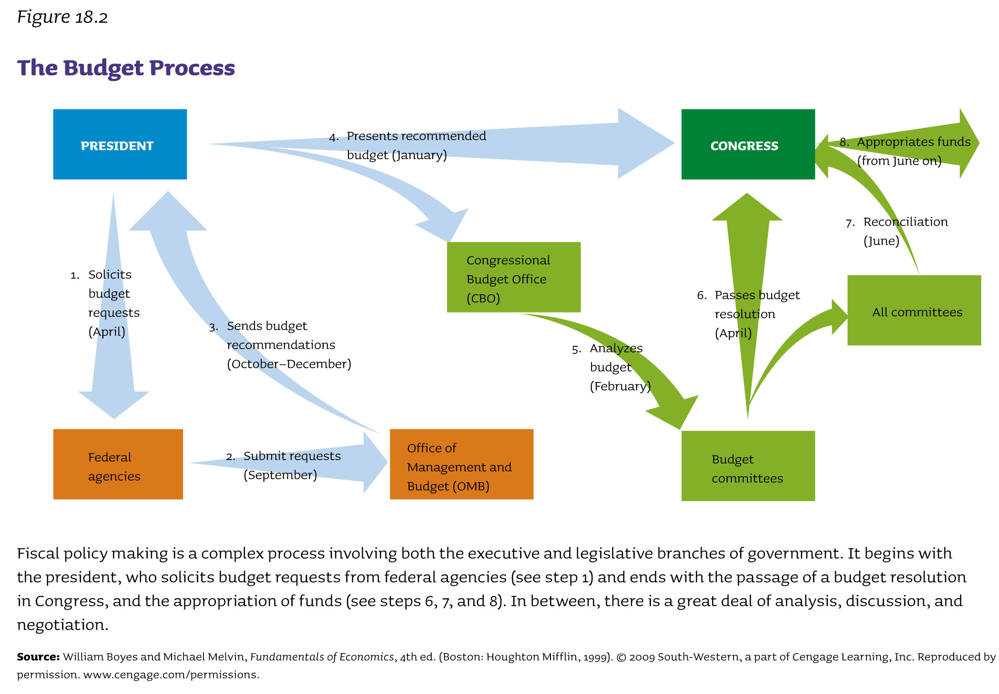

Slide 21
Debt
Key Concepts
Debt – money borrowed and not yet paid back
Video: 10 Trillion and Counting
Deficit – situation in which government spends (expenditures) more than it collects in revenues
Surplus – situation in which government spends less than it collects in revenues (ha ha)
US Debt Clock
What observations can you make?

Slide 22
Tax policy
Supply-side economics: President Reagan’s economic plan, by which tax cuts would ultimately generate more, not less, government revenues
Progressive tax (e.g., income tax): tax whose rate increases with income
Regressive tax (e.g., sales tax): tax that requires poor people to pay a higher proportion of their income, compared with the well-off

Slide 23
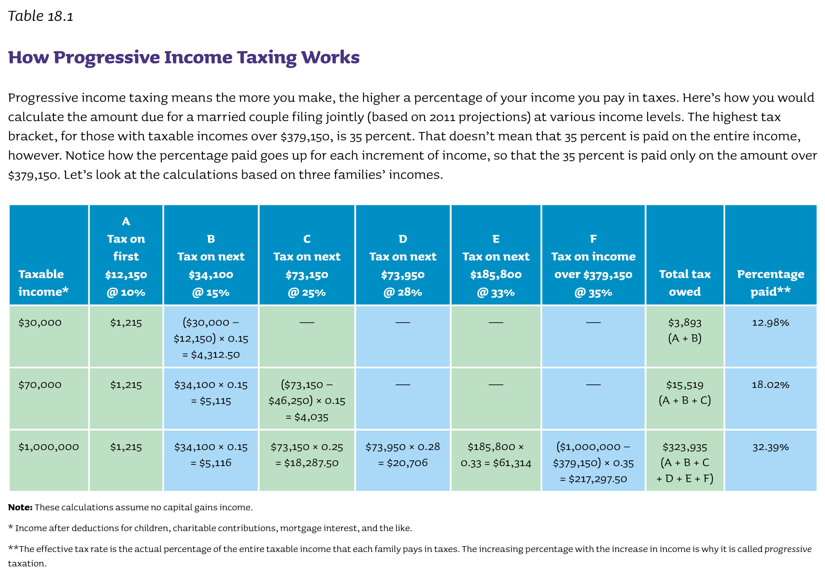

Slide 24
Reforming the tax code
A complex tax code
A tax code with a little something for everyone (e.g., homeowners, charities, business owners, students)

Slide 25
Reforming the tax code, cont’d.
Proposed reforms to the tax code
Flat tax: a tax system in which all people pay the same percentage of their income
Consumption tax: a plan in which people are taxed not on what they earn but on what they spend
Value-added tax (VAT): a consumption tax levied at each stage of production, based on the value added to the product at that stage

Slide 26
monetary policy
Monetary Policy – Form of government regulation in which the nation’s money supply and interest rates are controlled
Determined by the Federal Reserve Board of Governors

Slide 27
The Federal Reserve System
Federal Reserve Chair – Jerome Powell
Federal Reserve Board
Federal Open Market Committee
Twelve Federal Reserve Banks
Other Member Banks
Board of Governors
Seven members
Politically independent

Slide 28
Functions of the “fed”
Providing services – supply currency, clear checks, wire money
Serve as the governments bank – keeps track of government’s checking account and debt
Supervises banks
Making loans to banks
Helps individuals and businesses
Controls the money supply

Slide 29
Tools of monetary Policy
Open Market Operations
Buying and setting of government securities, or debt
Discount Rate
Rate of interest at which it lends money to member banks
Reserve Requirements:
Tight monetary policy: keeping money in short supply to hold back inflationary pressures
Loose monetary policy: getting more money into the economy to avoid a recession
Extraordinary Measures to Stimulate Bank Lending
Purchase of mortgage-backed securities
Credit easing
Quantitative easing

Slide 30
Economic regulatory policy
A Market Economy cannot exist without government
Regulatory Policy/Government Regulation
Aims to protect economic rights and make procedural guarantees
The Stimulus Bill passed by Obama sought to improve economy
Deregulation: the elimination of regulations in order to improve economic efficiency
What role does this play in business, labor, and trade?

Slide 31
Regulating business
Controlling monopolies
Antitrust policies
Interstate Commerce Act
Sherman Antitrust Act
Clayton Act
The states battle Microsoft
Recent regulations to mortgage and banking industries

Slide 32
Regulating labor
Protecting labor
Fair Labor Standards Act (minimum wage, limited work week, overtime pay)
Norris-La Guardia Act (elimination of yellow dog contracts)
Wagner Act (establishment of collective bargaining)

Slide 33
Regulating labor, cont’d.
Repealing labor protection
Taft-Hartley Act
Republican takeover of Congress in 1994

Slide 34
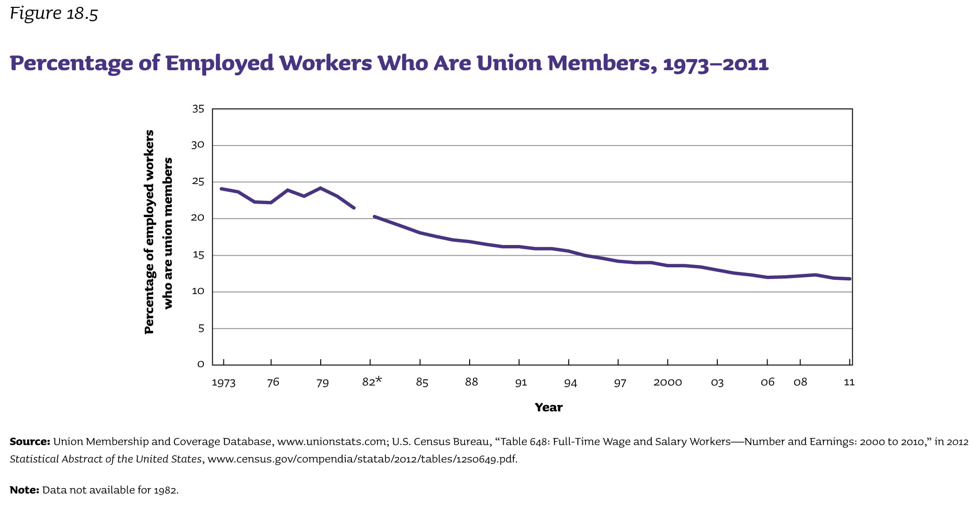

Slide 35
Regulating trade
Protectionism
Imposing trade barriers to make trading conditions favorable to domestic partners
Primary U.S. trade policy until the 1930s
Supported by labor and many environmental groups
Free trade
Encouraging open borders between trading partners by eliminating protectionist policies
Primary U.S trade policy today
Supported by the WTO, many businesses, and many economists

Slide 36
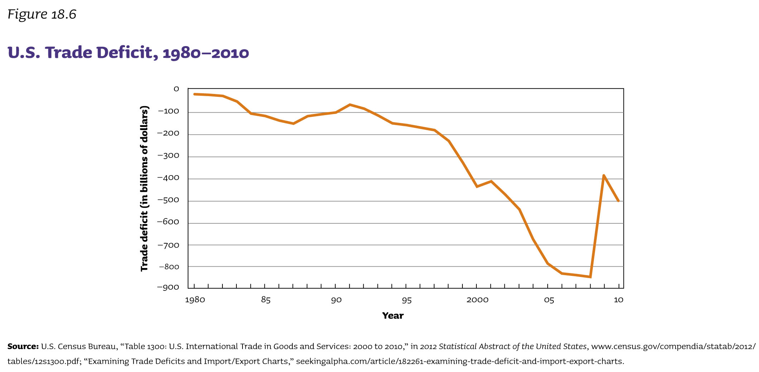

Slide 37
Health Policy
Medicare
Medicare – The federal government’s health insurance program for the elderly (65+) and disabled
Part A and B
Part C
Part D
Administered by the Department of Health & Human Services
Medicaid
Health insurance for the poor and disabled
Recipients must meet eligibility requirements.
Joint venture between the national and state governments
Notes:
Medicare was passed in 1965. It covers people who are 65 and over or disabled.
Medicaid was created at the same time as Medicare. Medicaid provides health insurance coverage for the poor and disabled. Recipients must meet eligibility requirements, such as showing that their income is below a certain level.
Medicare is a joint venture between the national and state governments. Federal block grants that cover 50 to 75% of Medicaid costs are given to the states, who must come up with the remaining funding themselves. States have considerable latitude in setting eligibility requirements and providing coverage. In 2015, Medicaid program provided health and longterm care coverage to nearly 70 million low-income Americans.

Slide 38
Health policy
Patient Protection and Affordable Care Act (2010)
Overview
Goal: Ensure Nearly All Americans Access to Health Coverage
Major Provisions
Government-run exchanges
Individual mandate
States Have Challenged the Program.
Republicans Vow to “Repeal and Replace.”
Notes:
The Affordable Care Act (ACA) of 2010 marked the first major change in national health policy since the adoption of Medicare and Medicaid in 1965.
The ACA established government-run health insurance exchanges financed by a number of taxes and fees, most notably an increase in the Medicare tax for individuals earning more than $200,000 per year. Americans had the option to buy into one of these exchanges or simply to retain their existing private health insurance. However, in one of its more controversial provisions, the ACA requires by law that every American have some form of health insurance or else pay a fine.
Many elements of the ACA have proven highly controversial. Some criticisms are ideologically based, arguing that the ACA was tantamount to a “government takeover” of the health care system and took control from the private sector. Others were practical, including higher than anticipated premiums and co-pays for some and the cost burdens placed on smaller businesses.
The ACA has been especially unpopular with state governments led by Republican governors and legislatures. These states believed that the act is an infringement on states’ reserved powers, and more than half of the states sued to block implementation of the policy. However, in 2012, the Supreme Court upheld the constitutionality of the individual mandate and, again in 2015, upheld the legal status of the health-insurance exchanges. Some Republicans still vow to “repeal and replace” the ACA

Slide 39
Health Policy
Public Health
Tools to Protect Public Health
Immunizations, education, advertisements, regulations
Medical Research
National Institutes of Health
Health Threats Related to the Environment
Air and water pollution
Lead poisoning
Notes:
The government also plays a role managing the spread of infectious and chronic disease through immunizations, education, advertisements and regulations. The national government also finances medical research, primarily through the
National Institutes of Health (NIH).
An increasingly important area of public health involves interactions between humans and the environment. In response to alarm among scientists and an outcry by the public, governments have increasingly taken steps to reduce the health problems associated with pollution by regulating the industry. Starting in the 1970s, the United States initiated a large number of programs intended to stave off the harmful effects that pollution has on health and created the Environmental Protection Agency, which now serves as the primary environmental regulator in the country.
There are many persistent health threats related to the environment. Most recently in 2016, discovery of dangerously elevated levels of lead in the water supply of the city of Flint, Michigan, has raised questions about the efficacy of environmental
policy. The crisis erupted after, as a cost-saving measure, the city government switched the water supply from Lake Huron to the polluted Flint River. Even after the discovery of elevated levels of lead, which is especially harmful to children and
can cause irreversible organ damage, the response of governments at several levels was sluggish at best and perhaps criminally negligent at worst.

Slide 40
Education policy
No Child Left Behind Act (2002)
Greater federal control over education policy
High standards and measurable goals
Became unpopular over time
Every Student Succeeds Act (2015)
Returned control to the states
Withdrew federal support for the Common Core
School Choice
Vouchers
Charter schools
Notes:
Enacted in 2002, the No Child Left Behind Act (NCLB) was designed to monitor student achievement in schools, paying special attention to disadvantaged student populations. The aim was to set high standards
and establish measurable goals as a method of improving American education across states.
In response to growing disillusionment with NCLB, the law was replaced at the end of 2015 with the Every Student Succeeds Act (ESSA), which restores greater control to states over issues of accountability, teacher quality, and
school improvement. ESSA also largely withdrew federal support for the Common Core State Standards Initiative.
Another area of controversy in educational policy has been the question of “school choice,” which argues that if a child is attending a failing school, students and their parents should have the option to enroll at a more successful institution. This can be done through vouchers or charter schools.

Slide 41
Education policy
Higher Education
Research grants
Military academies
Improving access to affordable higher education
Federal Direct Student Loan Program
College Work Study
Pay As You Earn loan repayment plans (2015)
Cap repayments at 10% of income
Notes:
Federal government policies tend to provide indirect support of higher education through research grants and financial assistance to students. The federal government also funds the U.S. Military Academy, U.S. Naval Academy, the U.S. Air Force Academy, the U.S. Coast Guard Academy, and the U.S. Merchant Marine Academy.
But the biggest topic in higher education policy in recent years has been access and student loan debt. The Federal Direct Student Loan Program allows students and families to borrow money to pay for college, with repayment (with
interest) deferred until a student graduates or leaves college. College Work Study programs, providing part-time jobs to college students while enrolled in school, also rely on federal funding.
Following on the heels of the mortgage crisis of the mid-2000s, some public policy analysts fear that a bubble in student debt could lead to wide-scale defaults and the need for a taxpayer bailout. A range of public policy responses have been considered, including expanding access to educational grants, cutting interest rates, and easing repayment terms. For example, in 2015 the Department of Education expanded Pay As You Earn loan repayment plans (PAYE) so that student loan repayments would be capped at 10 percent of current monthly income.

Slide 42
Education policy
Notes:
Title IX of the education amendments of 1972 greatly expanded educational and athletic opportunities for women. As a result of gender equity requirements, women’s basketball programs
have gained more prominence in recent years.

Slide 43
social welfare policy
Social Security Act (1935)
Beginning of permanent U.S. welfare state
Three major components
Old-age insurance (Social Security)
Public assistance for the needy, blind, and families with dependent children (known as SSI)
Unemployment insurance and compensation
One of the most successful government programs
AP Essay: 2006 #2: Essay Question and Rubric
Notes:
A major legacy of the New Deal was the creation of the Social Security program. The intent of Social Security was to go beyond various “emergency” programs such as the Works Projects Administration (WPA) and provide at least a minimum of
economic security for all Americans. Passage of the Social Security Act in 1935 thus represented the beginning of a permanent welfare state in America and a dedication to the ideal of greater equity. The act consisted of three major components: (1) old-age insurance (what we now call Social Security); (2) public assistance for the needy, aged, blind, and families with dependent children (known as SSI); and (3) unemployment insurance and compensation.

Slide 44
Social Welfare (Today)
Entitlement Programs
Non–means-tested
Means-tested
Old Age, Survivors, and Disability Insurance
Most employees covered by Social Security
Current workers fund benefits for retirees.
Unemployment Insurance
Covers people who lose their jobs through no fault of their own
Notes:
Many social welfare programs are entitlement programs, government benefits which all citizens meeting eligibility criteria—such as age, income level, or unemployment—are legally entitled to receive. Some of these are non–means-tested programs that provide cash assistance to qualified beneficiaries, regardless of income. In contrast, means-tested programs require people to have incomes below specified levels to be eligible for benefits. Benefits of means-tested programs
may come either as cash or in-kind benefits, such as help with finding employment or child care.
The Social Security program is a non–means-tested program that began as old-age insurance, providing benefits only to retired workers. Its coverage was extended to survivors of covered workers in 1939 and to the permanently disabled in 1956. Social Security is not, as many people believe, a pension program that collects contributions from workers, invests them, and then returns them with interest to beneficiaries. Instead, current workers pay employment taxes that go directly toward providing benefits for retirees.
Unemployment insurance is a social insurance program financed by a payroll tax paid by employers. The program benefits full-time employees of companies of four or more people who become unemployed through no fault of their own. Unemployed workers who have been fired for professional faults or who have quit their jobs, or those who are unwilling to accept suitable employment, do not receive benefits.

Slide 45
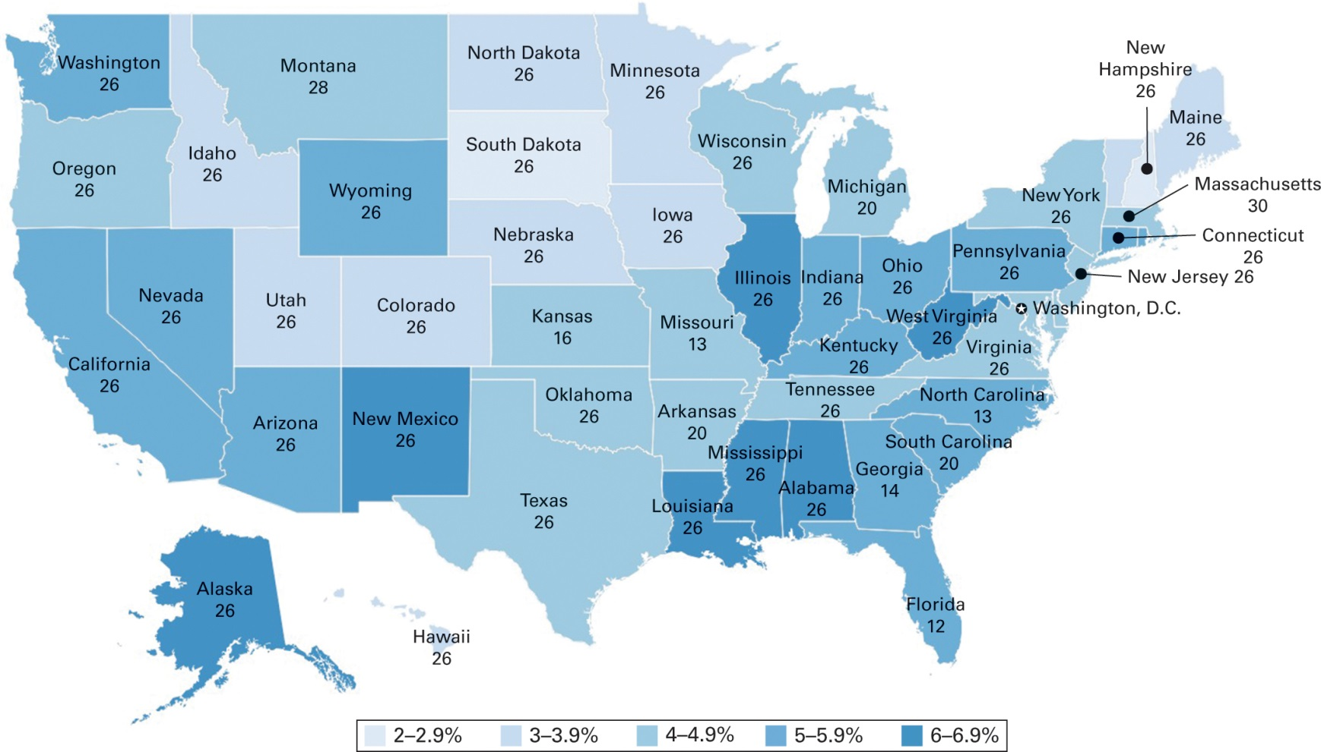
Unemployment Rates (by state)

Slide 46
Social Welfare (Today)
Supplemental Security Income
Covers needy elderly and disabled citizens
Family and Child Support
Aid to Families with Dependent Children
Temporary Assistance for Needy Families
Supplemental Nutrition Assistance Program
Food assistance for the poor
Notes:
The Supplemental Security Income (SSI) program is a means-tested program that began under the Social Security Act as a government benefit for needy elderly or blind citizens. In 1950, Congress extended coverage to needy people who were permanently and totally disabled. To be eligible for SSI, beneficiaries can have only a very limited income; the lower an individual’s income, the higher the SSI payment. SSI beneficiaries may also have only a limited number of possessions. The total of an individual’s personal resources, including bank accounts, vehicles, and personal property, cannot exceed $733.00.
The Aid to Dependent Children program is a means-tested program first established as part of the Social Security Act in 1935. By the 1990s, the growth of this program began to attract widespread criticism from many conservatives and moderates, including Democratic President Bill Clinton. In what is regarded as the biggest shift in social welfare policy in decades, a new family and child support program called Temporary Assistance for Needy Families (TANF) was created to replace AFDC. TANF switched the funding of welfare from an open-ended matching program to a block grant to the states, which were also given more flexibility in reforming their welfare programs toward work-oriented goals.
SNAP was formerly known as food stamps. The food stamp program was originally an effort to expand domestic markets for farm commodities. Food stamps provided the poor with the ability to purchase more food, thus increasing the
demand for American agricultural produce. The method of delivering the food stamp benefit has changed dramatically over time. For much of the program’s history, the benefit was administered as actual paper coupons—quite literally, food “stamps”—given to citizens who were eligible for relief. Today, the program is administered entirely using an electronic debt program, much like an ATM card.

Slide 47
Ongoing Challenges in Social and Economic Policy Making
Agenda Setting
Opportunities are rare.
Policy Adoption
Incrementalism
Implementation
Policies change shape as they are carried out.
Policies subject to challenge
Notes:
Social and economic policy has a long and complex history in the United States, as has been discussed in this chapter. However, in each of the issue areas considered, public policy challenges have yet to be solved.
At the agenda-setting stage, rarely do all three streams—problems, policies, and politics—converge to open a policy window. In addressing education reform, for example, the competing values of local control versus national standards makes it
difficult to gain consensus on a solution. Policy often is formulated in the context of uncertainty. The actual results of the enormous bailout and stimulus bills of 2008–2009 were very hard to predict: Could the banking system be protected? Would these actions stave off a full-scale economic depression? Policy makers do not always have complete information on the long-term costs and benefits of proposed policy solutions. As a result, incrementalism often describes the policy adoption stage.
At the implementation stage, policies can change shape as they are carried out day to day by the bureaucracy. As schools implemented No Child Left Behind and the Common Core, new standards and teaching to the test changed the content and delivery of information to K–12 students—and then feedback from parents, teachers, and others led to calls for further reform. Policies also are constantly subject to challenge, in routine evaluations and budget allocations, or in constitutional challenges in the courts. Challenges to the Patient Protection and Affordable Care Act jeopardized full implementation of Obama’s health care initiative.

